Slide 1
Programmed learning material
M.Uma Dharshini

Slide 2
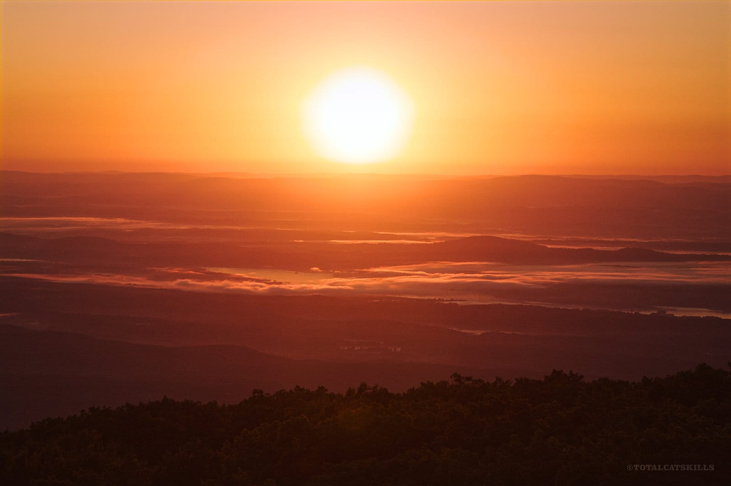

Introductory frame
She works in a garden
Find out the noun in the above sentence
The sun rises in the east

Slide 3
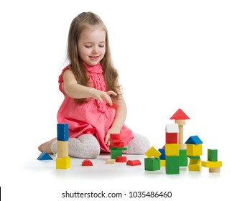
Common noun
It is a non specific person, place or thing
The girl was playing
What is the common noun here
Garden Girl Child Playing

Slide 4
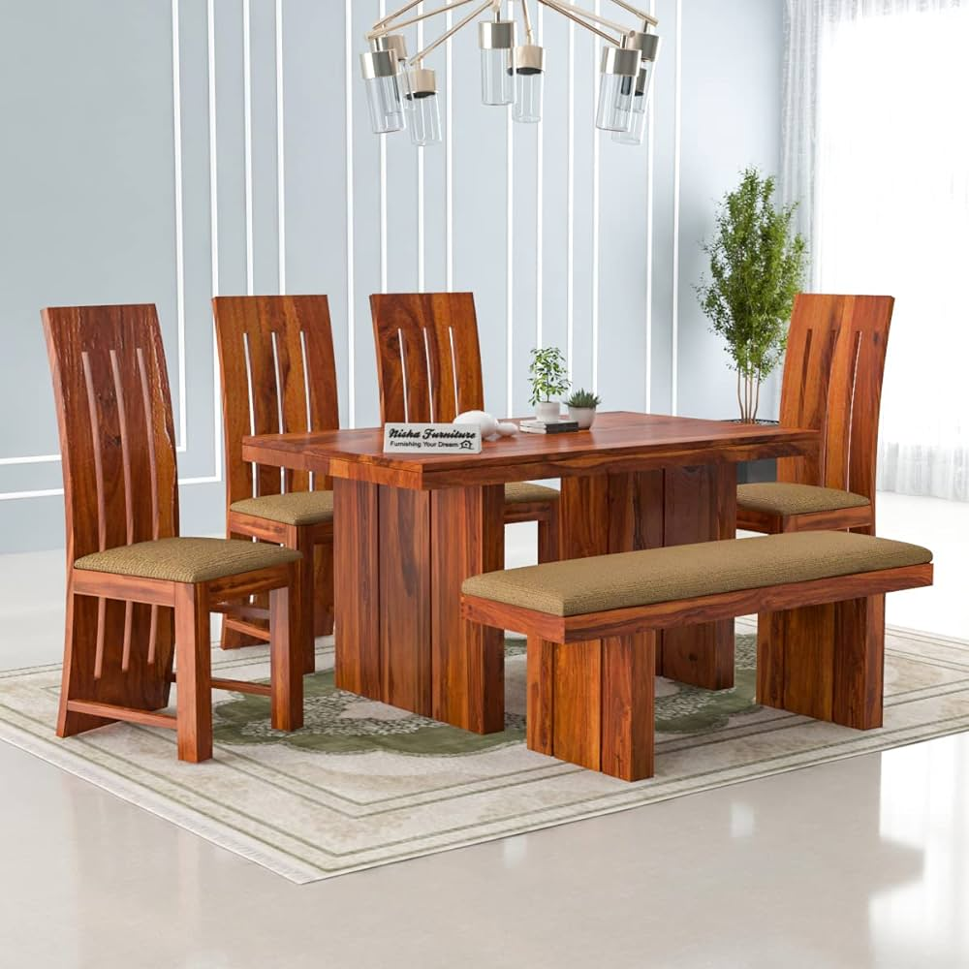
Material noun
It is a substance or a material we can see and touch and used for making things.
Eg: stone,wood,glass
Find out the material noun
The furniture was made of wood
Person. Furniture. Thing. Wood

Slide 5
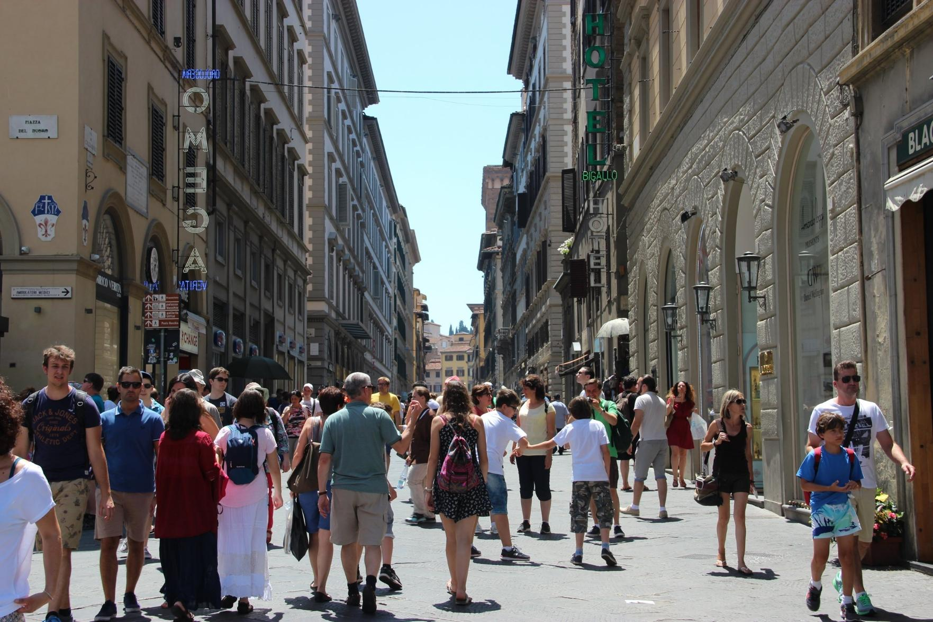
Collective noun
Any noun that is used to name a group of something.
Eg : people, animal, school.
Find out the collective noun in below .
A crowd of people gathered in a specific place
Crowd. People Place. Man

Slide 6
Summary
Common noun
Material noun
Man
Child
Country
Collective noun
People
Animal
School
Stone
Wood
glass

Slide 7
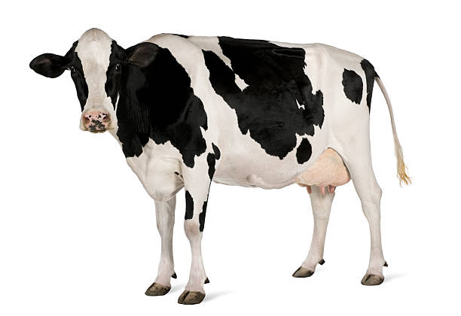
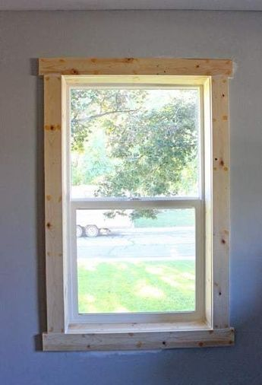
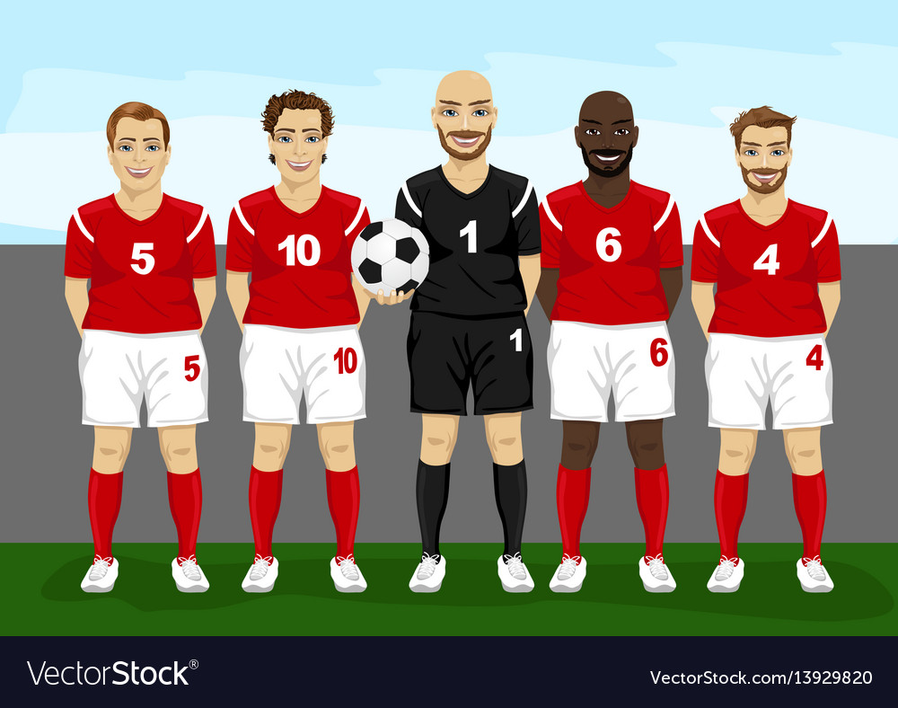
Testing frame
1. A cow is a useful _____
2. This window is made of _____
3. A _______ of players.

Slide 8


Slide 9


Slide 10


Slide 11


Slide 12


Slide 13


